Slide 1
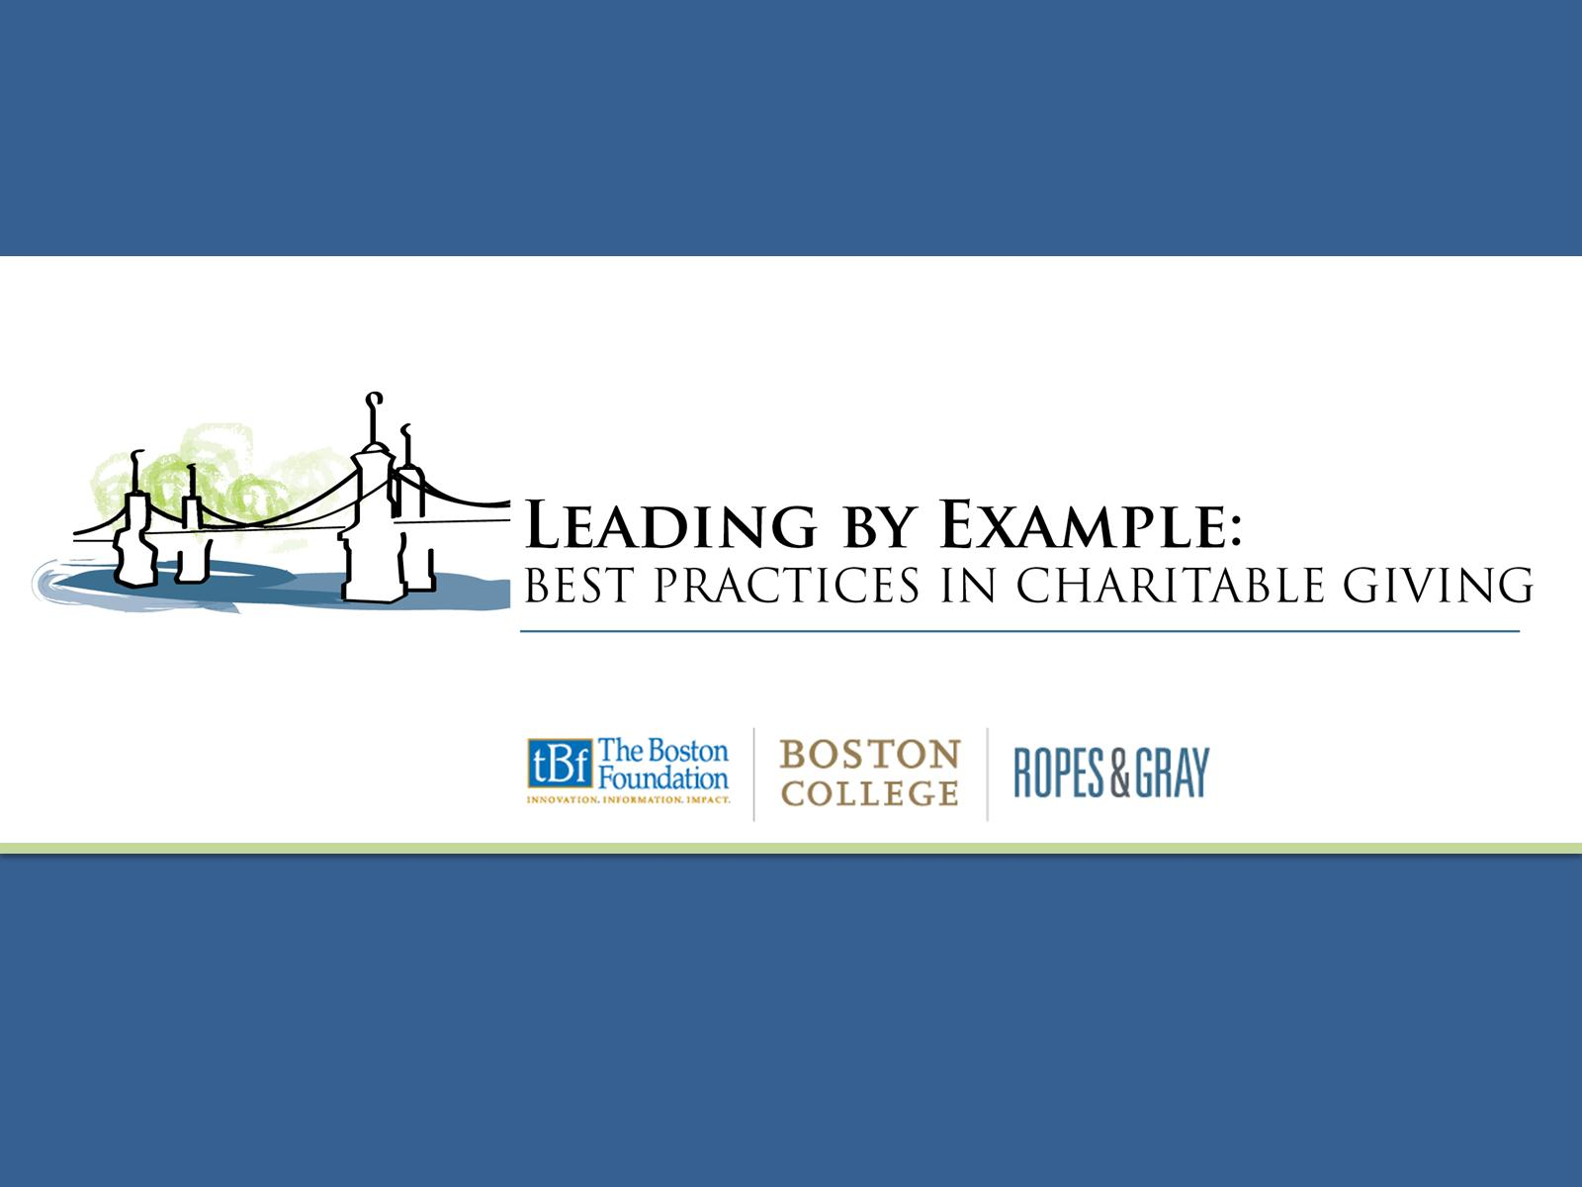
Beyond The Classroom:
Unlocking Student Potential
Moderator: Elizabeth Pauley
Panelists: Yully Cha, Mary Walsh, Rebekah Salawasser, Gaby King, and Eric Esteves

Slide 2
Yully Cha
Executive Director, Bridge Boston Charter School

Slide 6
Mary Walsh
Professor, Boston College, City Connects

Slide 7
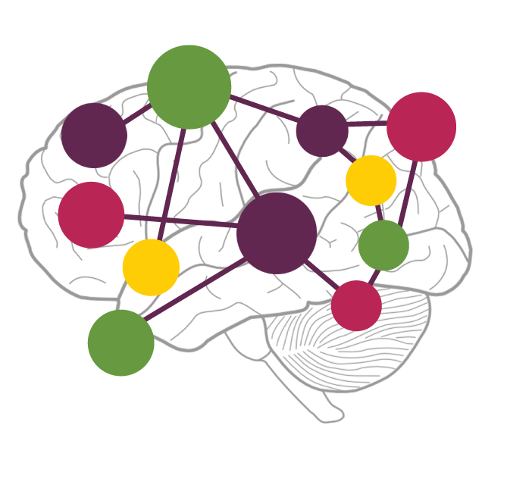
City Connects
Developmental Science
Intervention
Personalized
Multiple domains
Strengths and needs
Systemic
Engaged
School and community

Slide 8
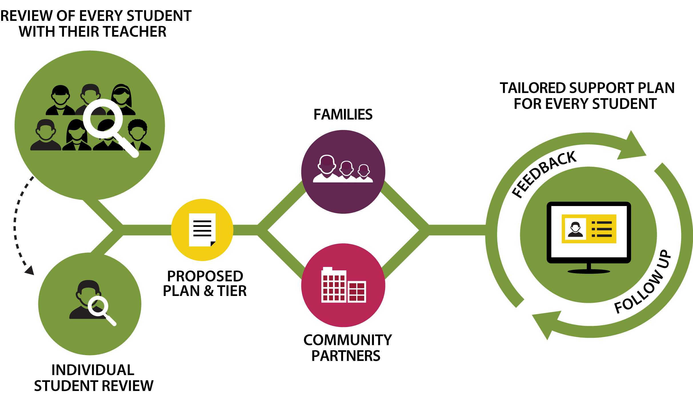
The right service to the right child at the right time

Slide 9
City Connects Makes a Difference
Outcomes for Students in Elementary School
higher standardized test scores in reading and math
higher test scores on reading and math for immigrant students
After students leave City Connects
higher scores on statewide math and English language arts tests in middle school
lower rates of retention in grade and chronic absenteeism
half the probability of school dropout
Economic analysis (Columbia University)
City Connects returns $11 in societal benefits for every dollar invested

Slide 10
Rebekah Salawasser
Executive Director, Scholar Athletes

Slide 11
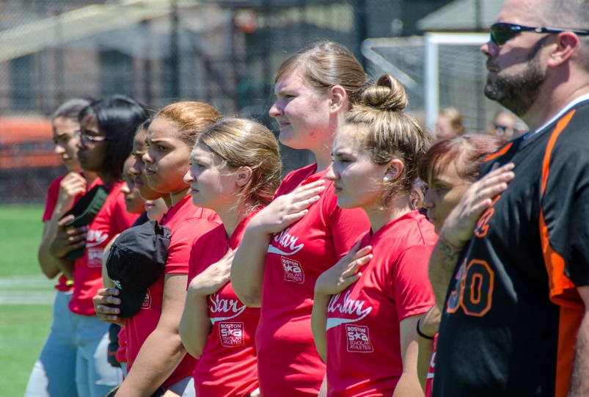
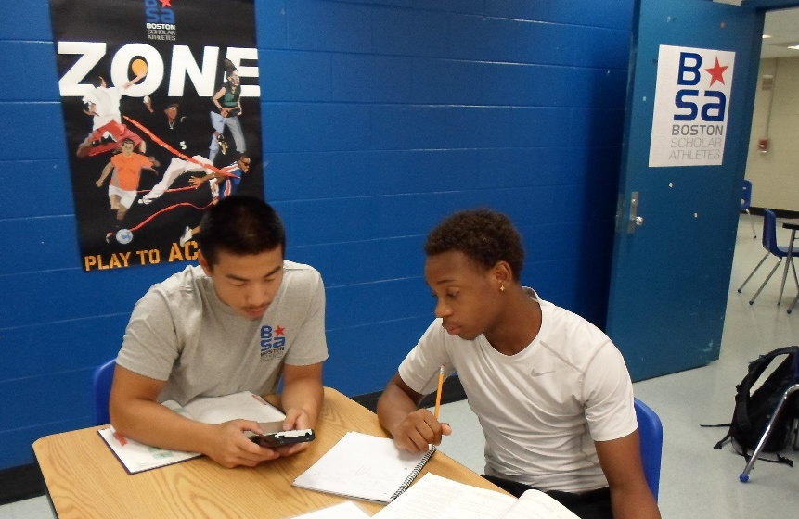
What We Know
Athletics are a powerful vehicle for youth identity formation, confidence building, valuable life-skills and personal health and wellness
At-risk youth benefit from consistent relationships with adults who work with and advocate for them over their four years of high school

Slide 12
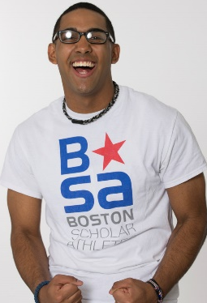
Scholar Athletes Overview
MISSION = Support academic achievement through athletics.
VISION = Reduce the opportunity gap for urban public high school
22 Zones – school-based learning centers – embedded within Boston and Springfield high schools, open during and after school.
5,000 young people served by full-time Program Coordinators through 3 Core Program Areas:
Academic Coaching and Mentoring
Health & Wellness
Post-Secondary Planning
Scholar Athletes leverages the power of sport to motivate and facilitate young people to perform better in school. By doing this, we are in a unique position to make a significant impact on a student’s social-emotional development.

Slide 14
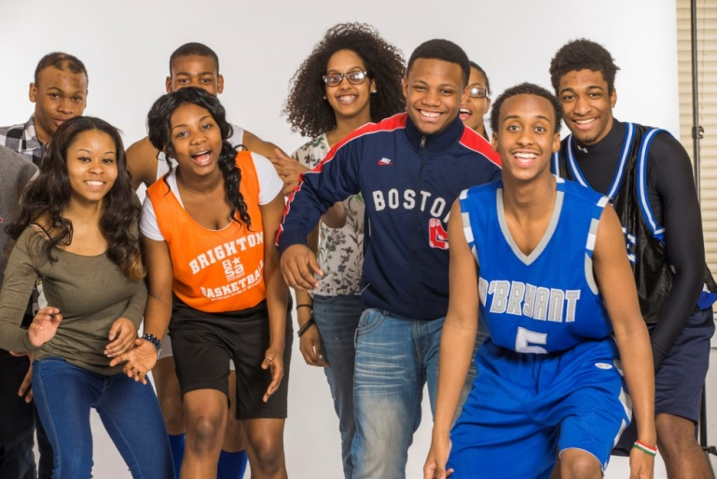
Building our Young People: Non-Academic Supports
WHY: Just being a “good student” isn’t enough. A student must be able to: self-advocate with adults or peers, demonstrate resiliency when faced with a challenge, etc.
WHAT: Successful SEL is not a standalone program – it is central to and integrated within ongoing learning. SEL skill building permeates through all of the work we do within our programming
HOW: Trained, full-time staff in each Zone, ensuring SEL skill development is a robust part of all 3 of our Core Program Areas
BASB’s ACT framework: identified 11 of the 12 SEL skills
Must evaluate and assess our efficacy in implementation

Slide 15
Thank you!
2015-2016 Impact
5,000 Zone Members
95% Graduation Rate
96% Graduating with Postsecondary Plans
172 Point Increase on SAT
Over 120 College Scholarships Leveraging
$4.2+ Million in College Education
55 Intramural Sports Teams & 1500+
Participants

Slide 16
Gaby King
Executive Director, uAspire

Slide 18
The National leader in addressing the college affordability crisis
MISSION: uAspire works to ensure that all young people have the financial information and resources necessary to find an affordable path to – and through – a postsecondary education.
VISION: uAspire is committed to reaching the day when all young people have the opportunity to reach their full potential by graduating from college, regardless of their families’ financial resources or college experience.

Slide 19
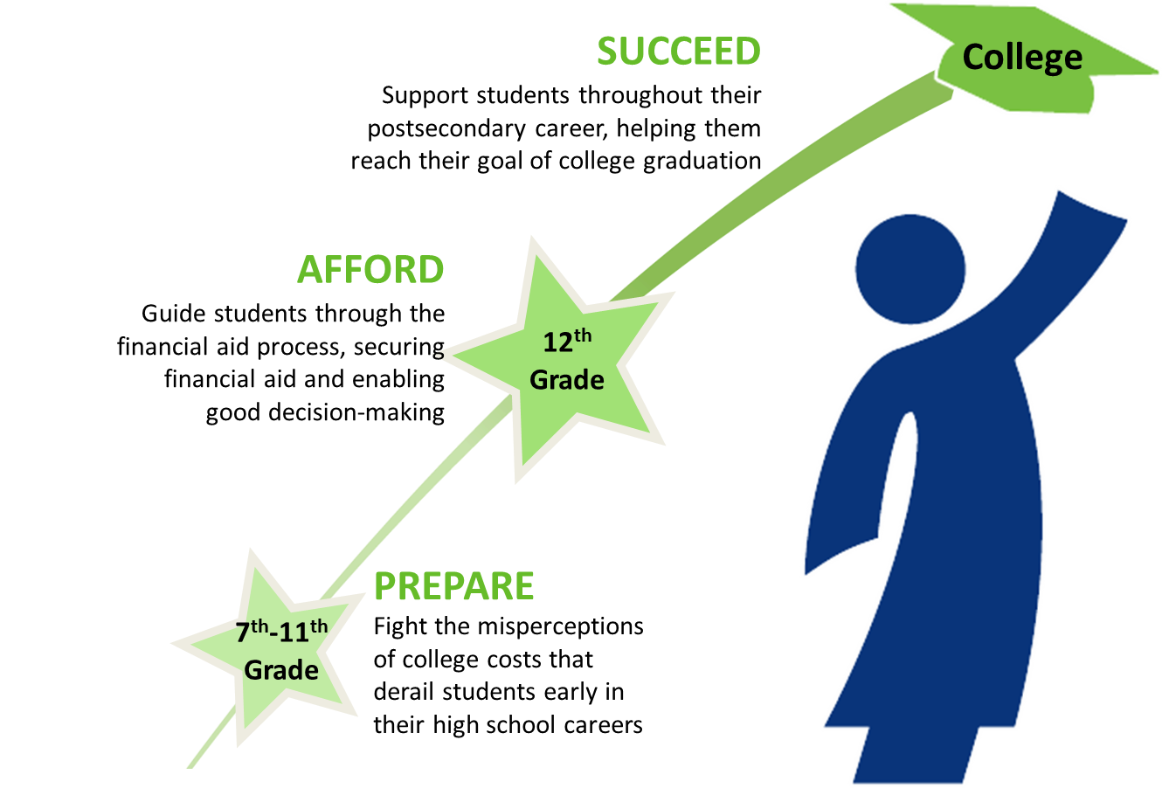
The uAspire’s Program Model:
Delivering Impact:
Advising in person one-on-one
Advising through the use of technology
Training and Technical Assistance
Systems Change

Slide 20
uAspire’s Local and National Partnerships
Programmatic Partners
Key Funders
Through our various impact models, uAspire works at both local and national levels with a wide range of partners.
uAspire could not achieve the impact that we do without the generous support of a diverse set of funders.
Chirag Foundation

Slide 21
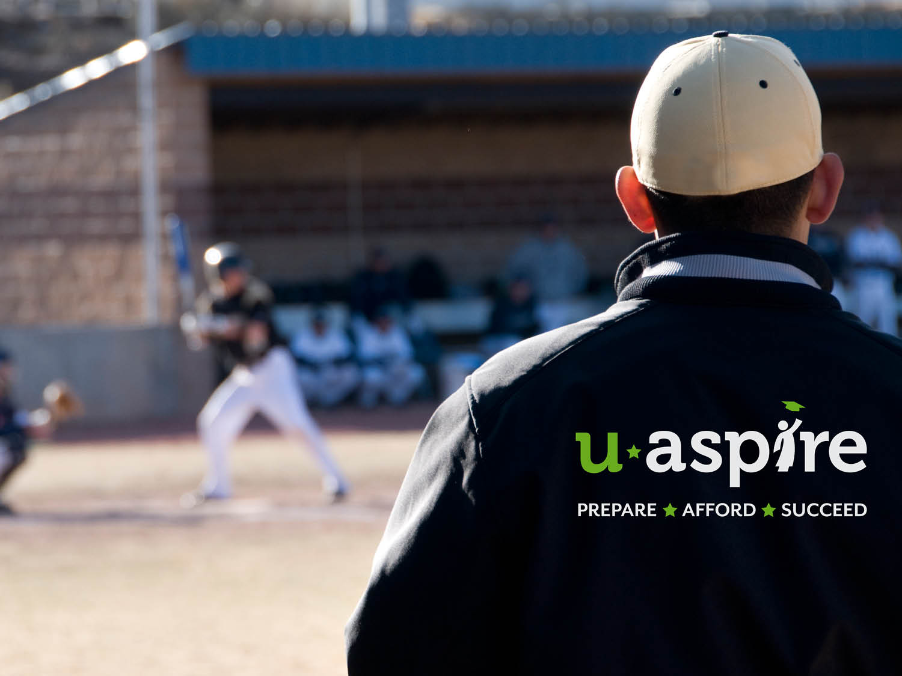

Slide 22
Eric Esteves
Social Innovation Fund Director, Success Boston

Slide 25
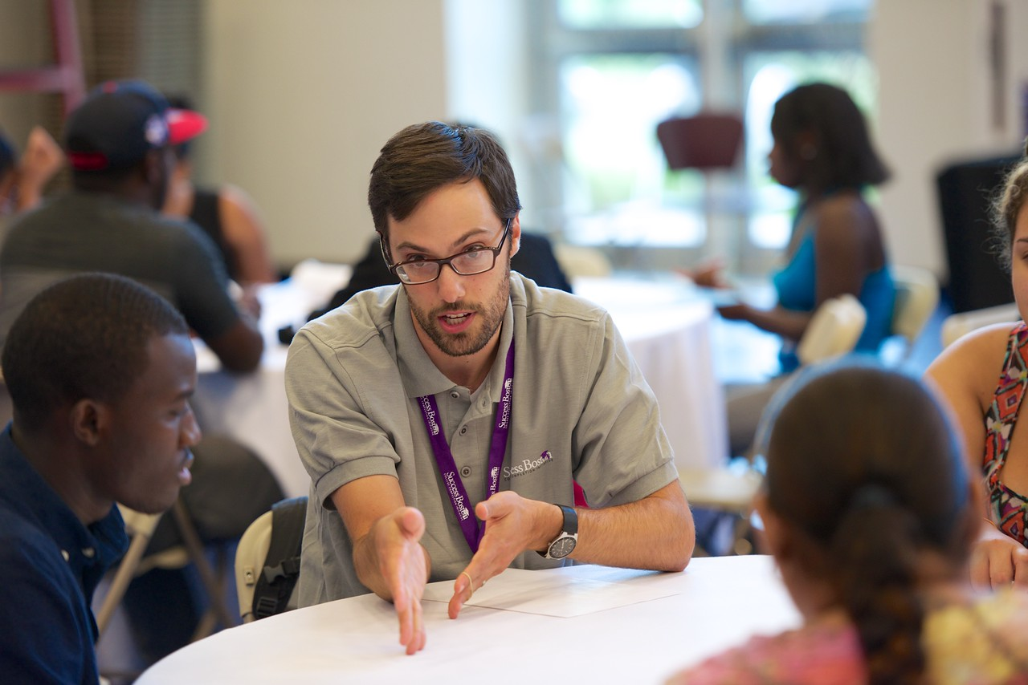

Slide 28
Thank You!

