Slide 1
Happy Giving
Michael Norton
Harvard Business School
Notes:
The project is motivated by the idea that firms and customers often have misaligned interests, particularly around issues of customer engagement. Beyond simply transactions or purchases, there are many activities in which firms want higher and more frequent customer engagement, but in which customers are not inherently motivated to participate

Slide 2
How would you spend $5 to make yourself the happiest?

Slide 3
Think of the last $5 that you spent – what did you spend it on?

Slide 4
How would you spend $5 to make yourself the happiest?
Think of the last $5 that you spent – what did you spend it on?

Slide 5
If you think money can’t buy happiness, you’re not spending it right

Slide 6
If you think money can’t buy happiness, you’re not spending it right

Slide 7
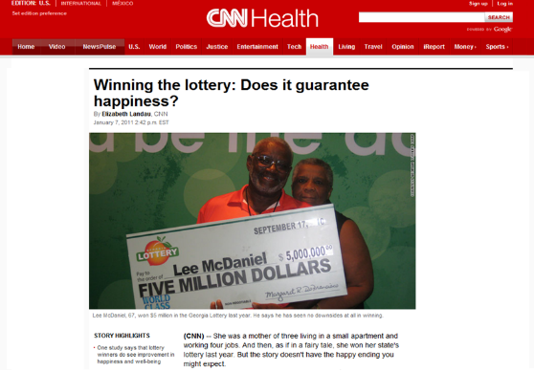
When I win I am going to buy my own little mountain and have a little house on top.

Slide 8
I would fill a big bath tub with money and git in the tub while smoking a big fat cigar and sipping a glass of champagne. Then I'd have a picture taken and dozens of 8x10 glossies made. Anyone begging for money or trying to extort from me would receive a copy of the picture and nothing else.

Slide 9
STUFF

Slide 10
Shifting the focus outward
Invest in Others

Slide 11
One Vancouver morning…
Personal Prosocial
bill, expense, charitable donation,
gift for self gift for others

Slide 12
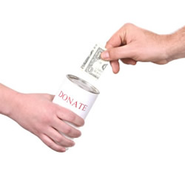
What they bought
Personal
Prosocial
Notes:
.

Slide 13
How corporate philanthropy usually works
Company A wants to donate $100,000
Charity X

Slide 14
Allow employees to donate on the company’s behalf
Company A wants to donate $100,000
Donation split among employees
Charities X, Y, Z…
Notes:
Working alongside a large company, we were able to adapt this giving model and allow employees to donate the allotted funds on their company’s behalf. So in this case, the company decided they wanted to give a lump some to charity, say 1,000,000 again, but instead of donating this money on one charity as one lump some, the donation was split amongst a number of employees and they were able to make a donation to a charity of their choice – with the help of a company called Karma Currency that facilitates the process.

Slide 16
Allow customers to donate on the company’s behalf
Company A wants to donate $100,000
Donation split among customers
Charities X, Y, Z…
Notes:
Working alongside a large company, we were able to adapt this giving model and allow employees to donate the allotted funds on their company’s behalf. So in this case, the company decided they wanted to give a lump some to charity, say 1,000,000 again, but instead of donating this money on one charity as one lump some, the donation was split amongst a number of employees and they were able to make a donation to a charity of their choice – with the help of a company called Karma Currency that facilitates the process.

Slide 18
One Final Intervention
Pseudo-Set Framing

Slide 19
Pseudo-sets – arbitrary and meaningless–encourage people to expend more resources in pursuit of completion
Notes:
And so just to sum it all up, we have found evidence that pseudo-set framing, even arbitrary and devoid of meaning, ecourages people to expend ore resources in pursuit of completion.

Slide 20
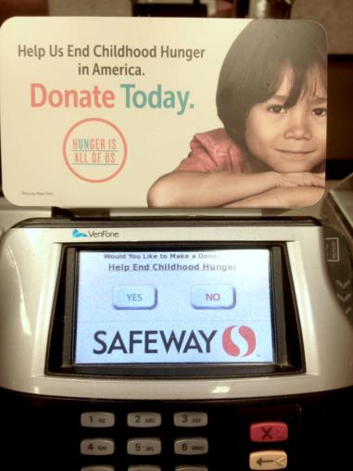
Charitable Donations
$25
$50
$75
$100
Notes:
To start, let’s consider charitable donations, which we’ll explore in some of our studies today. Here again, incentives are not necessarily the answer, and the same misaligned interests exist; firms – or non-profits – want more frequent and sizable donations, but after an initial donation, people may feel satisfied with their efforts and not contribute more – even when it’s financially feasible.
For instance, we can almost always contribute one more dollar at the checkout of a grocery store, but how many times should we donate? Maybe we donated last time we visited and feel like we’ve done enough.
Or think about a one-time decision among a repeated menu of donation options. Maybe we could donate $100, but why expend the extra resources when $25 or $50 feels just as satisfying?
In these two cases, the marginal benefit of donating another time or another amount is unclear. So the question is – how can we change this? How can we make one or two friend referrals or product reviews or donations feel “not quite good enough” and prompt people to increase their efforts or resources—on their own terms?
Well consider how your choices might change if we simply reframed the tasks and your progress. For instance, consider how your decision to donate at the supermarket might change if I depicted your donation history as part of a “set” of donations. Now you can see that you’ve donated once, but you can also see four unmet opportunities to accumulumate more donations. Or rconsider what you might choose to donate if I reframed these donation scales as part of a “share” or “unit” or “set” that should be completed? Now suddenly, donating on one or two occasions or giving $25 or $50 doesn’t feel quite so satisfying. In either case, haven’t explicitly set your goal or given you a target, but simply by configuring tasks like this, I can send a normative cue of how many you “should” do.
And as I’ll show you in the studies today, simply introducing this “pseudo-set frame” – or simply grouping discrete tasks or items together as part of a cohesive set — makes people more likely to engage until the set has been fulfilled. This conveys a satisfying endpoint that is both fulfilling to the consumer and advantageous and malleable for the firm.
5:22
5:24

Slide 21
Pseudo-Set Framing
Number of times you’ve contributed
25% of one share
($25)
50% of one share
($50)
75% of one share
($75)
$25
$50
$75
$100
One full share ($100)
$100 = One Donation Share
Notes:
To address this question, we devised a very simple yet effective framing technique that meaningfully changes behavior. Just by grouping discrete tasks or items together as part of a cohesive set — we can make people more likely to engage until the set has been fulfilled.
For instance, consider how your decision to donate at the supermarket might change if I depicted your donation history as part of a “set” of donations. Now you can see that you’ve donated once, but you can also see four unmet opportunities to accumulumate more donations. Or rconsider what you might choose to donate if I reframed these donation scales as part of a “share” or “unit” or “set” that should be completed? Now suddenly, giving $25 or $50 doesn’t feel quite so satisfying. In either case, haven’t explicitly set your goal or given you a target, but simply by configuring tasks like this, I can send a normative cue of how many you “should” before you feel complete.
And as I’ll show you in the studies today, simply introducing “pseudo-set framing” changes the number of times and amount of money people donate, the number of tasks they’re willing to do, and even the amount of risk they’re willing to assume – all without the use of incentives.
5:06

Slide 22
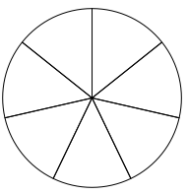
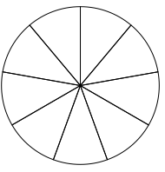
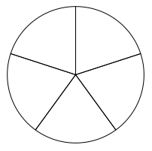
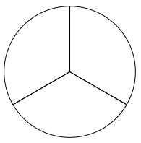
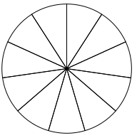
Pseudo-Sets are flexible…
Notes:
We show that pseudo-sets work because—like actual sets—they convey distinct reference points, and thus elicit some predictable behaviors.
To quickly illustrate, consider this pie chart. No matter how many times I subdivide the circle, the endpoint is still the same: completion of the whole pie. But this isn’t the case with multiple units, even in the identical quantity. It’s unclear where to stop.
Thus, because it’s a distinct reference point, we should see two things happen: 1) people should exert more effort to reach the reference point, and 2)

Slide 23
Notes:
We are asking participants to help us write holiday cards to seniors in nursing homes who are particularly isolated.
We ask that every participant complete at least ONE card.
You can write as many or as few cards as you’d like, and can stop at any time.
The cards were set up like this. On the right side of everyone’s desk was a stack of 12 cards, and on the left, was a collection envelope into which the completed cards were placed. All of the cards were identical, and we gave all participants a specific script to write in each card, so that variety-seeking wouldn’t play a role in the number of tasks completed. The only thing that differed from card-to-card was the name that people signed.

Slide 24
Control
Pseudo-Set
“We will collect as many cards as possible. We will send roughly 200 cards to each nursing home. Each senior will receive one card.”
“Within each package, we are batching the cards in sets of 4.”
Thanks!
You have completed ONE card.
Would you like to write another?
Yes
No
Thanks!
You have completed 25% of one batch of cards.
Would you like to write another?
Yes
No
Notes:
As a further bit of instructions, we told everyone that we’d be collecting as many cards as possible, and that we’d send 200 to each nursing home and that each senior would receive just one card. We did this to make sure people understood that their individual contributions were part of a much bigger campaign, and therefore they wouldn’t be able to “complete” the whole project alone. That helped us keep impact perceptions constant across the condtions. For pseudo-set participants, we added an additional line that said: “within each package, we are batching the cards in sets of four,” hence evoking this notion of an arbitrary set.
Accordingly, we then tracked how many cards people wrote. Every time they wrote a card, participants had to click a button on their computer screen, and were prompted with this message. So control participants just got a simple count of how many cards they’d written, with the option to keep writing or stop.
But for pseudo-set participants, we framed their progress in terms of batches, rather than count. The idea was that – if people were cued to think in terms of sets that needed to be completed – they would be more likely to complete exact “batches” of cards, even though the batches were arbitrary and there was no incentive for completing more.

Slide 25
% completing full “set” (4 cards)
Control = 4.3%
Pseudo-Set = 39.8%
Notes:
So what did we find? On this page, I’ll show you a histogram of card completion by condition.
Not surprisingly, we found that control participants tapered off rather predictably after they’d completed their one required card. However, when we look at pseudo-set participants, we see distinctly different distribution, with a very definite spike at the point when people had completed a full “set” of cards. In addition to showing that the two distributions are distinct, we also measured the percent of participants who completed exactly “full sets” – or multiples of four. And we see that while only 4% did in the control condition, nearly 40% did in the pseudo-set condition.
So from this data, we can confidently say that our set completion rates happened beyond simply chance.
18:31

Slide 26
How complete does this donation amount feel to you?
Feels very incomplete
Feels very complete
Notes:
Testing this as the mediating variable.
We’ve already shown that people regard sets as distinct reference points at the end, but we also hypothesized that it would make all intermediate points appear different as well.

Slide 27
Happy Giving
Michael Norton
Harvard Business School
Notes:
The project is motivated by the idea that firms and customers often have misaligned interests, particularly around issues of customer engagement. Beyond simply transactions or purchases, there are many activities in which firms want higher and more frequent customer engagement, but in which customers are not inherently motivated to participate

